Slide 1
Southern California HVACR Collaborative
Citrus, Cypress, El Camino,
LATTC, Mt. SAC,
San Bernardino Valley,
College of the Desert

Slide 2




Collaboration
Convening of the Willing
Defined Problem / Opportunity
Common Outcome
Mutual Benefit

Slide 3




HVAC Project Drivers
A Perfect Storm

Slide 4
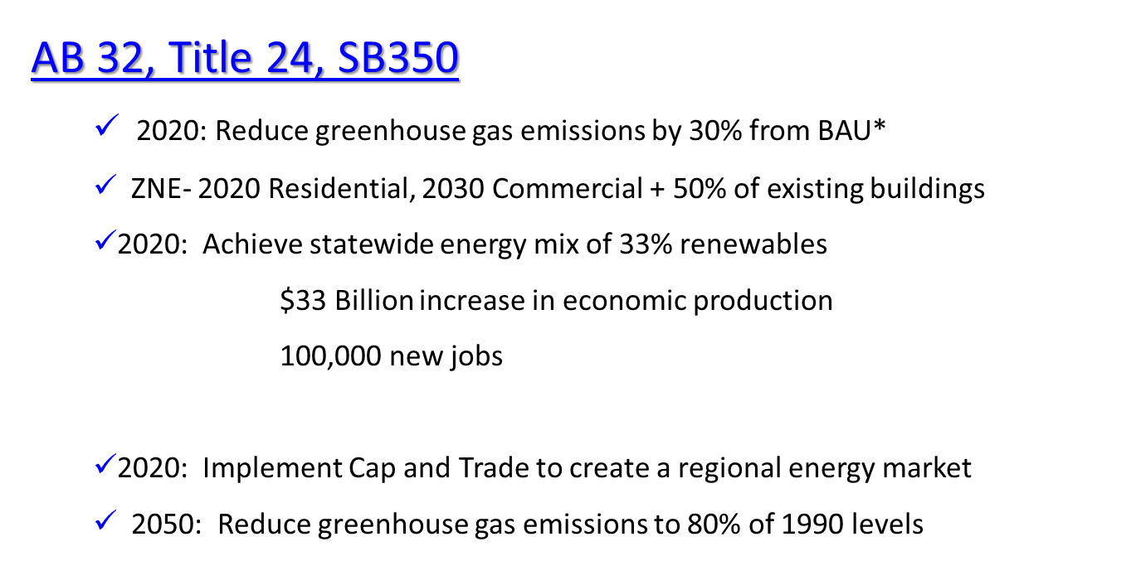
POLICY DRIVERS
*Business as Usual

Slide 5

California to reduce its GHG emissions to 1990 levels by 2020 (AB32)
CEC Demand Forecast
Potential Skills Gaps
50% Commercial Bldg. ZNE by 2030

Slide 6
OPPORTUNITY
$11 Billion Market
In California (2011-2020)
Investment in Energy Efficiency projected by:
The Don Vial Center for Employment in the Green Economy’
Workforce Education & Training Needs Assessment, 2011

Slide 7
Gap Analysis – HVACR
LA, Orange, Inland Empire
JOBS Gap | Annual Openings | Annual Completers HVACR/Environmental Technology
HVACR Installer/Service Techs – 12,000 | 1,300 | Community College (3 yr. Avg.) 400 (85 Environmental Technology) Apprenticeship ~100 Trade School Estimate ~100
Employment Ready Gap
Industry Needed Skills, Knowledge & Abilities | Completer Competencies

Slide 8

Inconsistent Programs

Slide 9

Misalignment with Industry

Slide 10
Energy Efficiency & Utilities
Sector
Skills Alignment & Upgrades
Career Pathway Development
Program Alignment & Upgrades
Faculty Professional Development
Industry Support

Slide 11
Sector Strategy
An Integrated Set of Initiatives
Designed to:
Support Industry priorities
Bridge Skills Gaps
Cultivate Career Pathways
Upgrade Priority Programs
Develop Faculty Competencies

Slide 12

Consistent Programs
Industry Advisory

Slide 13
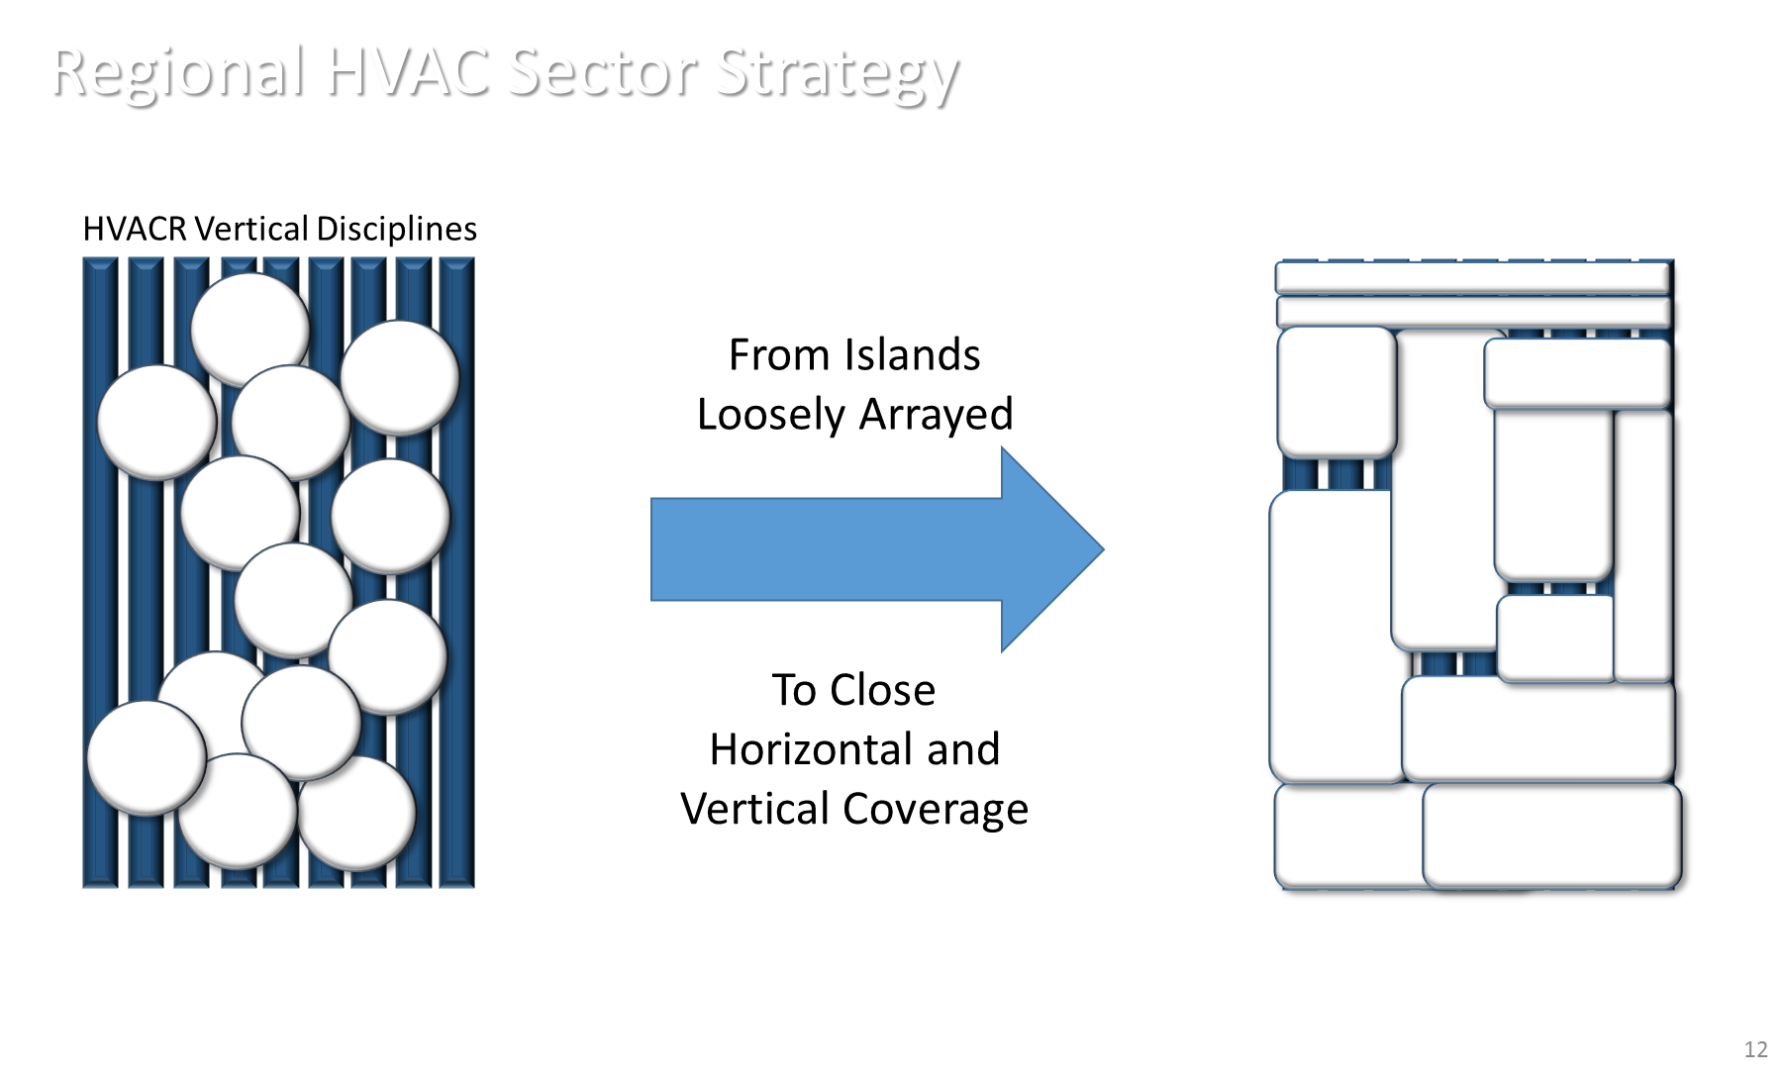
Regional Collaborative
Industry Recognized Credentials

Slide 14
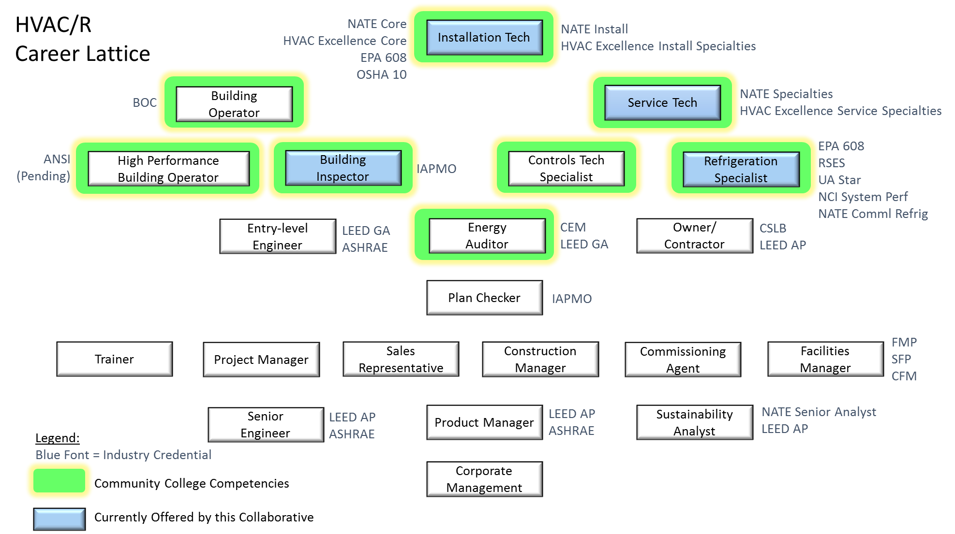

Slide 15








INDUSTRY CERTIFCATION
/ TERMINAL CERTIFICATE/DEGREE
Specialty Capstone
College A
Work Based Learning / CWE / Internship
REGIONAL ADVISORY
College A
College C
College E
College E
Prior Learning
Work Ready SKAs and Competencies
Prior Learning
Industry Recognized Credential - Units & Credits Transferable Between Colleges
Stackable Certificate
Common Outcomes
Citrus
LATTC
College of the Desert
San Bernardino Valley
Cypress
El Camino
Mt. SAC
Instructor / Resource Sharing
FOUNDATIONAL KNOWLEDGE, SKILLS & ABILITIES / COMPETENCIES

Slide 16
Sustainability
HVACR
Electrician
Plumber Steamfitter
Stationary Engineer
Construction
Mechanical
Facilities Manager
Electrician
HVACR
Stationary Engineer
Controls Specialist
Cal - CTP
Controls
Architects /Designers
Engineering Technicians
Construction Management
Commissioning /Audit
Building Science
Storage
Fuel Cell
Solar*
Wind*
Bio Fuel*s
Renewables
* Under Transportation Renewables Sector

Slide 17


Survey of Education & Training Programs
Program Intensity – Top Occupations
Community Colleges
CSUs
Architecture Mechanical Engineering
Electrical/Electronic Engineering Civil Engineering
Environmental Health Engineering
Industrial Technology
Architecture Tech / Drafting
Energy Systems – Renewables
Environmental Technology
Environmental Controls HVAC Technology
Electricians

Slide 18
